Slide 1
Q1 Reflection &
Q2 Kickoff

Slide 2
Table of Contents
Q1 Reflection
Where We Are Now
Recap of Learnings (including Q4 2023)
Discussion: What Went Well / Not so Well
Discussion: What / How to Improve Next Quarter
Final Discussion Questions
Q2 Kickoff
Revisit Yesterday’s Discussion
Revisit OKRs
Q2 Key Result Justification
Discussion: Q2 Alignment
Roles & Expectations
General
Equity Split

Slide 3
Q1 Reflection

Slide 4
Where We Are Now
As of today, March 30, 2024, we have completed ~6 months of work on Gluco
Within this 6 months we have done the following:
Collected data
Validated our idea
Spoken to potential customers
Programmed pre-processing steps for PPG using Python
Developed and deployed an ML model
Setup a NoSQL database
Created an MVP with FlutterFlow
Created design requirements
Despite this, we are far from where we need to be as we do not have a working prototype and our initial PPG-based methodology seems to be sub-optimal
In summary, we have executed on things and learned a lot, but remain in a similar place
Thoughts?

Slide 5
Recap of Learnings
From where we started back in August 2023, we made some progress, most of which had to do with learning:
We increased our knowledge of the non-invasive glucose monitoring space & market
We gained experience with using Python for pre-processing and machine learning tasks
We learned how to communicate with one another & better structure and plan tasks
We’ve learned more about the sheer scope of this endeavor
We’ve created and deployed an ML model using Python & TensorFlow
We’ve collected our own data
We’ve created a semi-working MVP using FlutterFlow, Firebase, and Flask (Python)
We learned about different sensors for capturing the type of data we need
Overall, we learned a lot during this time, all of which will lay the foundation for a more targeted approach going forward
What else did we learn during this time, if anything?

Slide 6
The Importance of Learning
Although it may seem like not a lot was actually done, there is value in learning
Both of us are trying to do something that people with more experience than us have failed - it’s not only likely, but also okay for our plans / goals to not go according to plan
All of the learnings mentioned in the previous slide (and the discussion) play an important role in teaching us what not to do
In the beginning, we came in to this project with n number of potential pathways; now, the number of potential pathways is < n
As we continue working on this project, we will continue pivoting until we arrive at our destination… these learnings simply reflect one of our initial “pivots”

Slide 7
Discussion: What Went Well / Not so Well
Jason to take notes during discussion
What Went Well:
Quarter planning, sprints, quarter primary tasks
Consistently communicating i,e,, pushing meetings back, progress on work, challenges
Consistent meetings
What Went Not so Well:
Code not working on all devices
Current configuration of code is not optimal / lack of clarity/context/background on the preprocessing / not respecting the code / technical requirements

Slide 8
Discussion: What / How to Improve Next Quarter
Jason to take notes during discussion
What to Improve:
Ability for code to work cross platform
Understanding of each others code
Robustness of code / code strength
Improve communication
Clarity surrounding objectives / long term goals
How to Improve:
Implement containerization / ussing out github more
Implementing readme files within code explaining purpose, current status, any additional context / inner workings
Implementing unit test for “finished” code
Providing mid-week updates when relevant
Quarterly kickoff / sprint kickoffs / weekly recaps in terms of where things fit

Slide 9
Final Discussion Questions
Below is a list of questions / thought starters that we can use to wrap up the Q1 Reflection meeting. If already discussed, fine to skip:
What do you truly want out of this project?
How capable do you think the current team is to bring this product to fruition?

Slide 10
Q2 Kickoff

Slide 11
Revisit OKRs
Objectives and Key Results (OKRs)
Old Objectives | New Objectives | New Key Results
(O1) Build Gluco’s core glucose monitoring technology | Completed | Completed
(O2) Incorporate Gluco’s core technology into a minimum viable product (MVP) | Expand capabilities with market insight, efficient processes, and a custom product | Robust Customer Validation Develop Custom Hardware Develop GitHub CI/CD Pipeline, Docker, MLOps, and DataOps Strategy Migrate Technology Stack to React Native
(O3) Ship Gluco | Obtain Product Market Fit (PMF) | Internal Testing Data Collection & Analysis Model Creation & Deployment Product Market Fit
(O4) Improve upon Gluco’s baseline metrics | TBD | TBD

Slide 12
Q2 Key Result Justification
The overall goal for this project is to bring to market the first non-invasive glucose monitor, Gluco
In order to do so, we need to 1) know the target audience the best, 2) build hardware that utilizes novel techniques relevant for this use case, and 3) build software that can manage collected data (at scale) and continuously re-train our proprietary model
Objective | Justification
(O2) Expand capabilities with market insight, efficient processes, and a custom product | By working on this objective over the course of Q2, we can 1) build robust knowledge on the market and customers, 2) create a product that opens up modeling possibilities as well as is future proofed for long-term testing and/or selling, and 3) develop internal processes that create an efficient workflow internally which will allow for long-term scalability
(O3) Obtain Product Market Fit (PMF) | Assuming Q2 goes to plan, we can shift our focus to putting that market insight and investment into product development to use. This objective will culminate in 1) a unique dataset utilizing new technology, 2) a proprietary ML model and data processing steps, and 3) metrics on real customer want for our product

Slide 13
Discussion: Q2 Alignment
Before continuing down this path, we need true alignment and belief in the proposed strategy. Use this time to discuss and reach consensus.

Slide 14
Q2 Roles & Expectations
Objective: Expand capabilities with market insight, efficient processes, and a custom product
# | Key Result | Deadline | Responsibility | Confirmation?
1 | Robust Customer Validation | June 30, 2024 | Jason Anderson | JA
2 | Develop Custom Hardware | June 30, 2024 | Jason Anderson / Tyrone Collins | JA / TC
3 | Develop GitHub CI/CD Pipeline, Docker, MLOps, and DataOps Strategy | June 30, 2024 | Tyrone Collins | TC
4 | Migrate Technology Stack to React Native | June 30, 2024 | Jason Anderson | JA

Slide 15
General

Slide 16
Equity Split
This discussion is not final, but I wanted to float some equity split ideas. I can see us getting incorporated after Q2, but wanted to share some thoughts and see if we can get some alignment.
Equity Split Proposal:
Set aside 15% of shares for early / impactful employees
Set aside 15% of shares for investors
Set aside 15% of shares for Jason Anderson due to being a co-founder
Vested automatically 1 year after startup incorporation
Set aside 15% of shares for Tyrone Collins due to being a co-founder
Vested automatically 1 year after startup incorporation
The leftover shares (40%) will be earned based on project contributions
THIS IS NOT A LEGAL BINDING DOCUMENT

Slide 17
Equity Calculations
For the sake of example, let’s say the person who is responsible for a key result gets 1 contribution point.
At the end of each year (or maybe a more frequent cadence), we add up the contribution points to date by each person and divide by the number of total contributions to date.
The distribution of contributions will be proportional to the amount of leftover shares one receives. This value will change each year and we’d need to align on when numbers get locked in.
NOTE: THE % OF SHARES UNUSED BY INVESTORS/EMPLOYEES WILL BE SPLIT 50/50 BETWEEN JASON ANDERSON AND TYRONE COLLINS

Slide 18
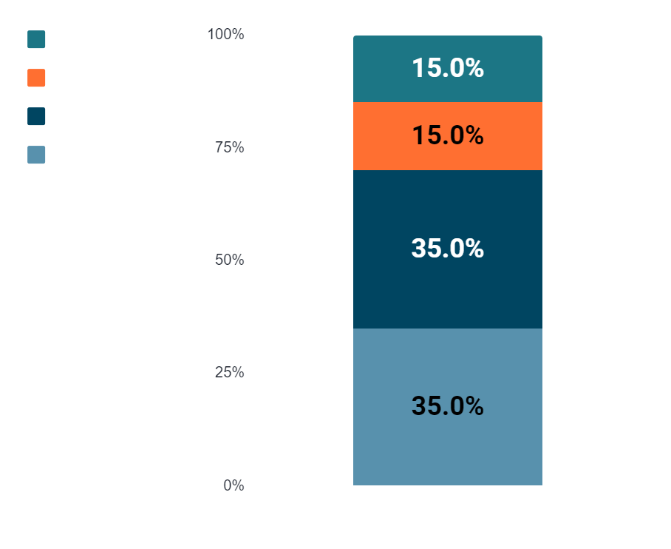
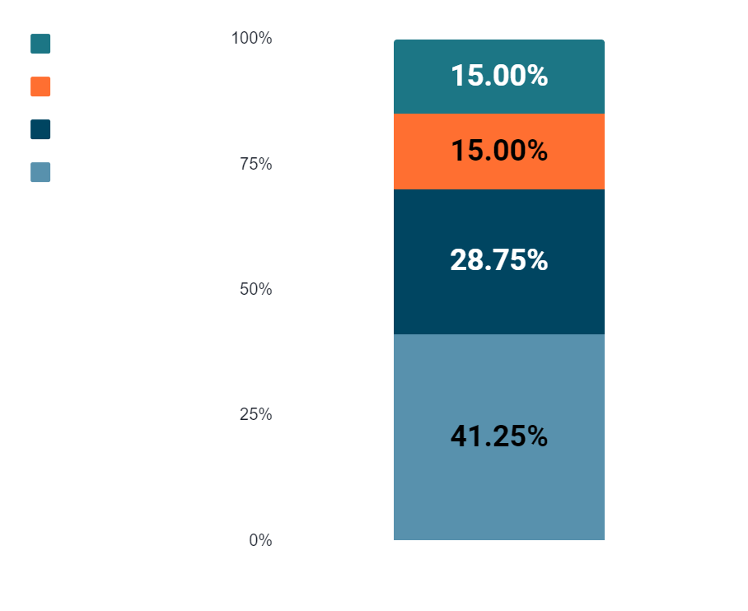
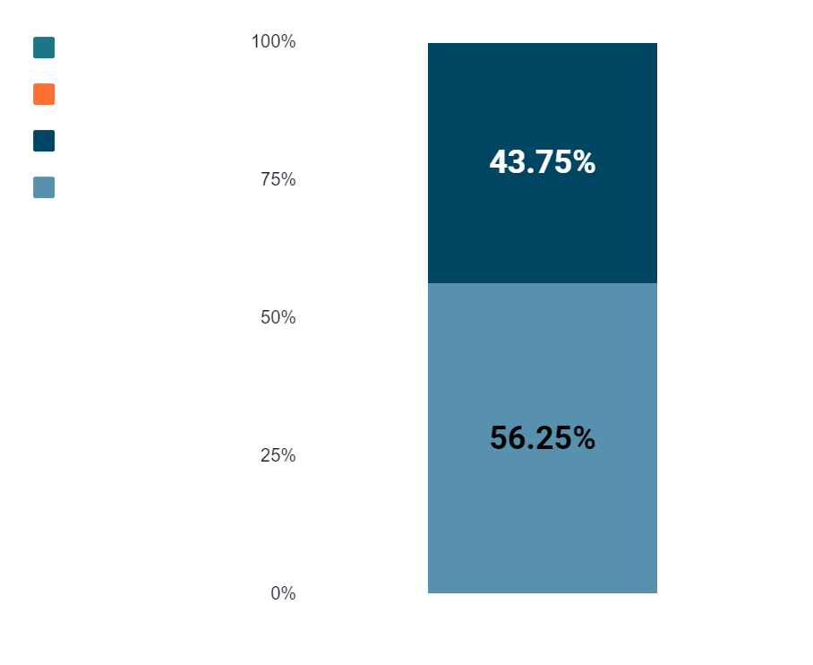
Potential Equity Outcomes
*Assumes throughout the project, we both feel like we’ve contributed equally
**If we use planned Q2 as an example this would be the hypothetical outcome
***If we use planned Q2 as an example and don’t use investors or hire employees prior to exit

